Slide 1
Aggregation of Results

Slide 2
Angles and Bond Lengths

Slide 3
RMSD of aligned trajectory
File | RMSD | std
Reference | 0.61 | 0.36
Reference v2 | 0.48 | 0.29
SVD 12_2 | 0.53 | 0.34
SVD 12_2 v2 | 0.71 | 0.34
Pure Simulation
Model

Slide 4
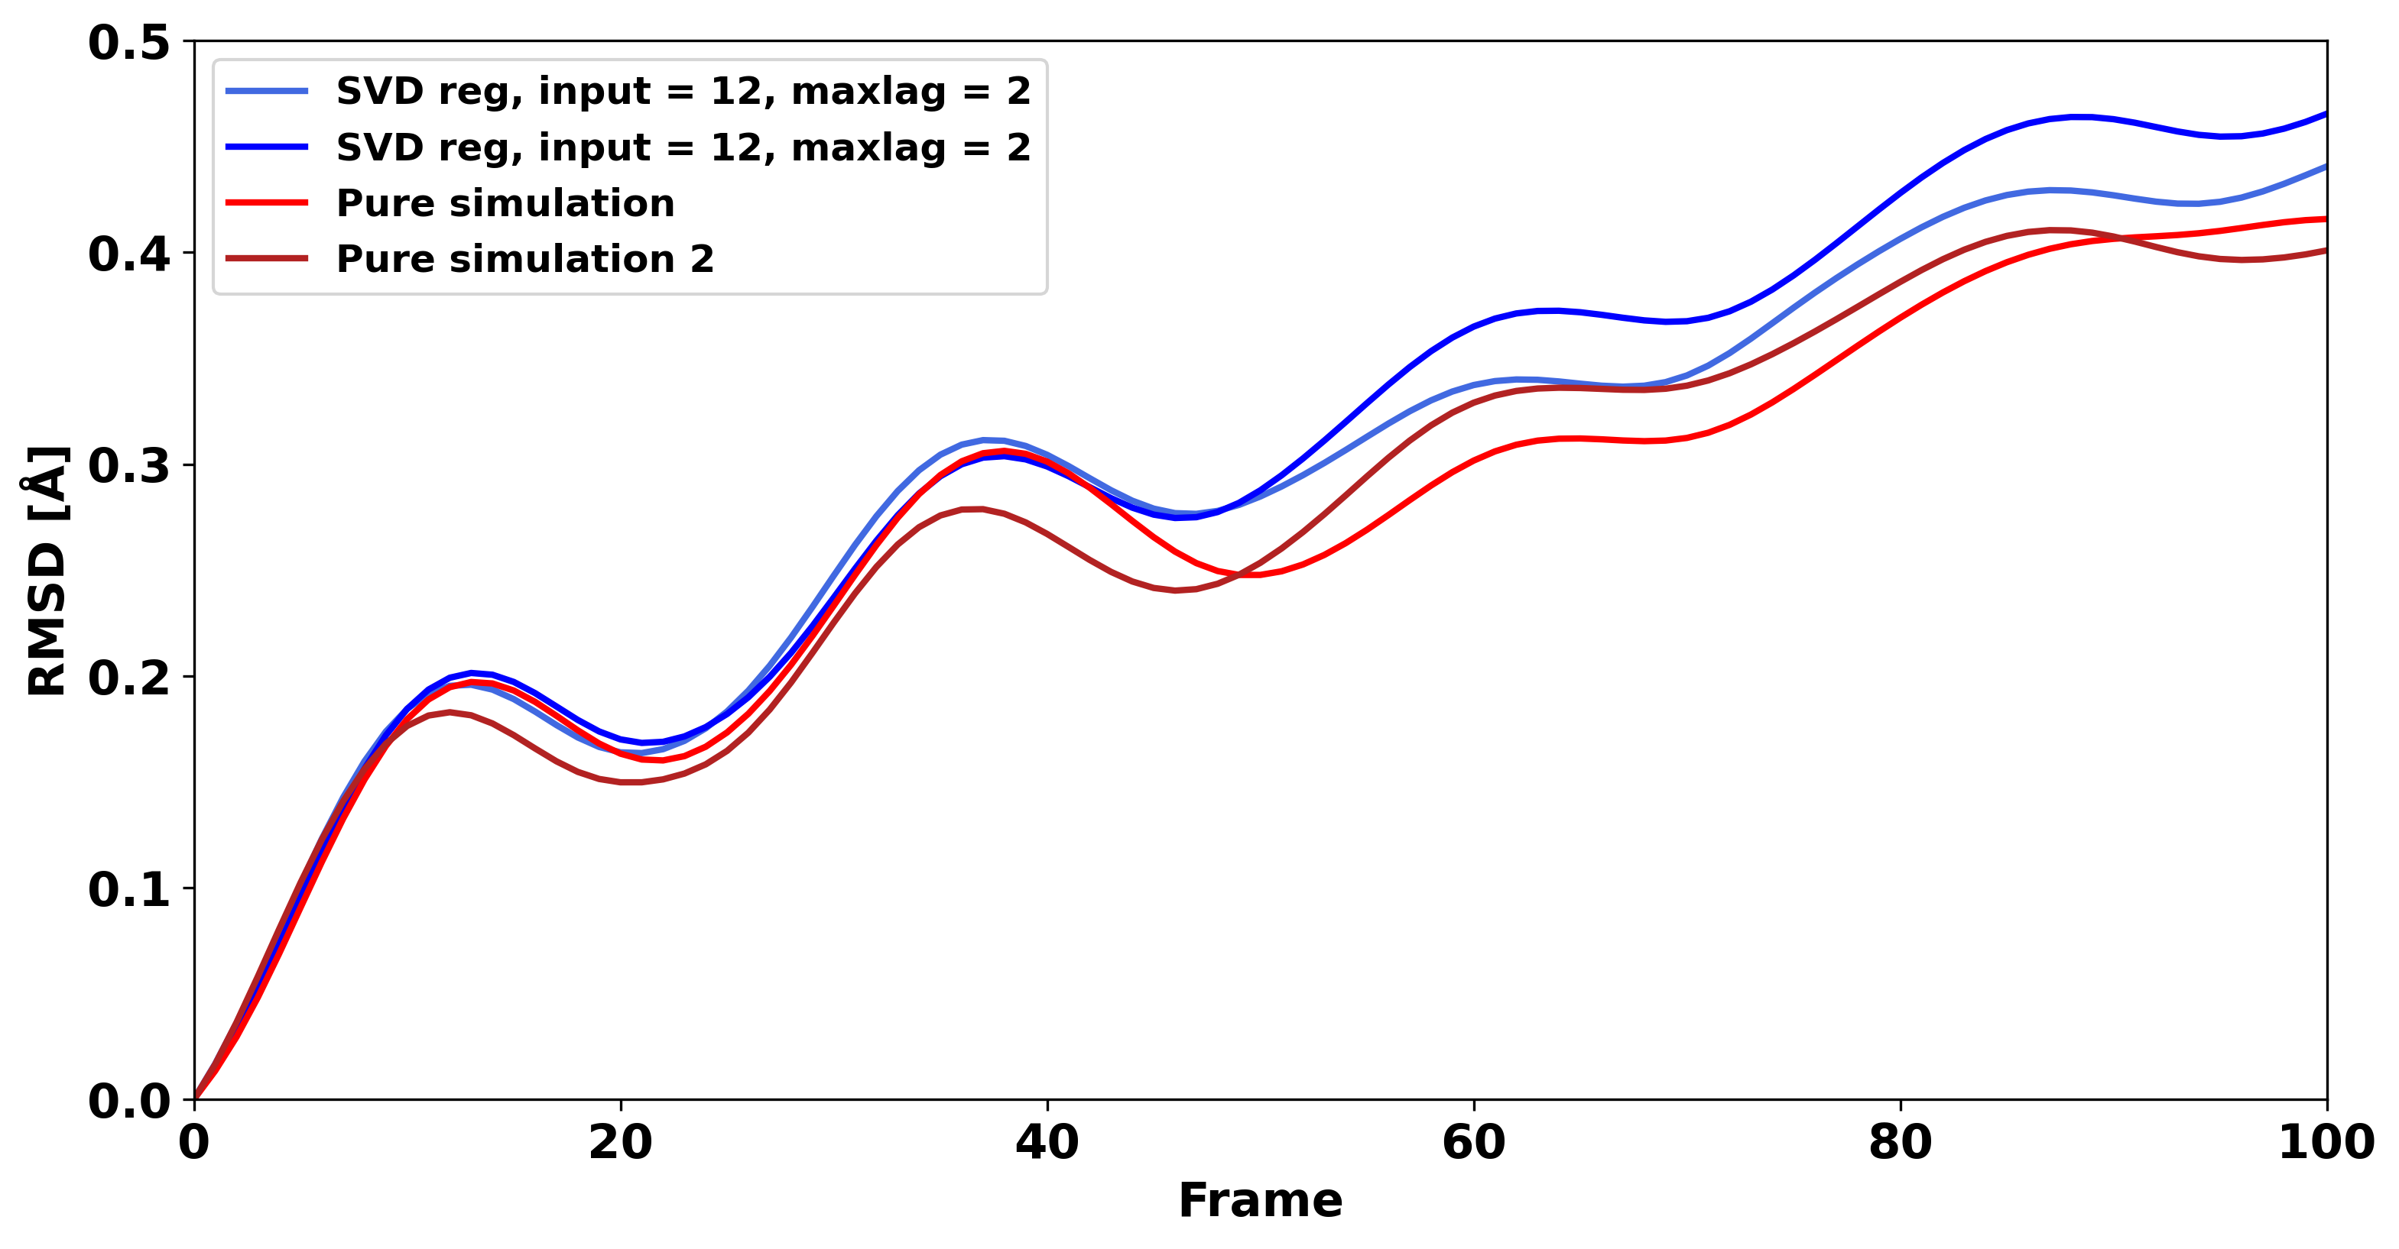
RMSD of pure trajectory

Slide 5
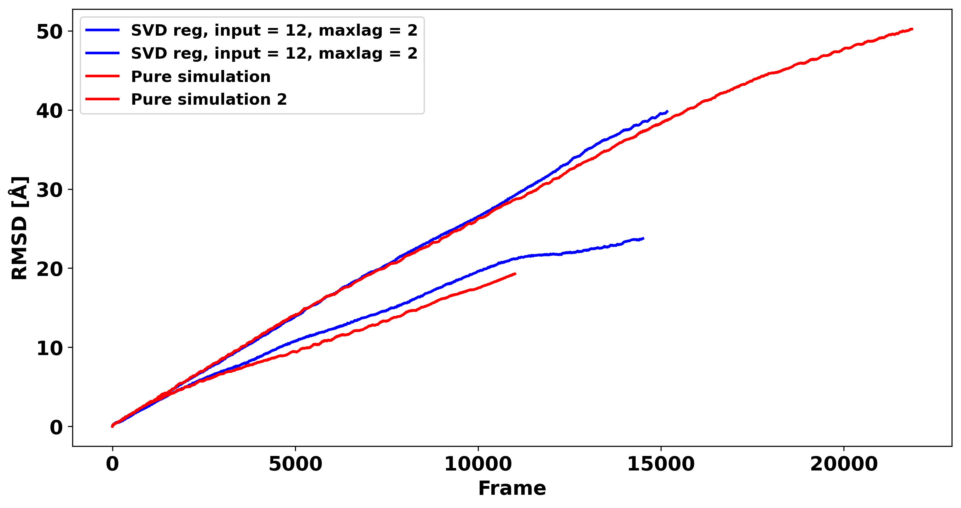
RMSD of pure trajectory

Slide 6
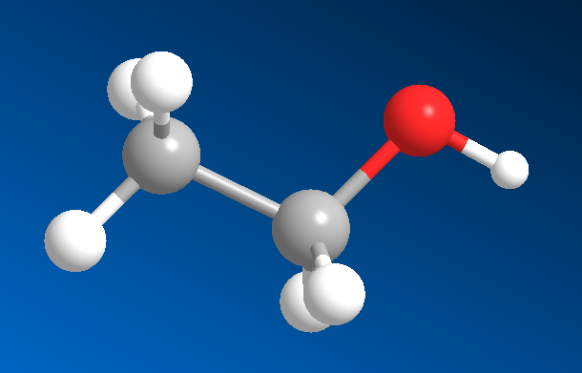
Conformational isomer rate – Vector analysis
Calculate the scalar projection of V2 onto V1
If the scalar is positive the molecule is in Anti configuration
If the scalar is negative the molecule is in Gauche configuration
V2
V1

Slide 7
Conformational Isomer Rate
File | Anti | Gauche
Reference | 0.699 | 0.301
Reference v2 | 0.68 | 0.32
SVD 12_2 | 0.497 | 0.503
SVD 12_2 v2 | 0.457 | 0.543
Velverlet | 0.547 | 0.453
Pure Simulation
Model
Sped-up simulation

Slide 8
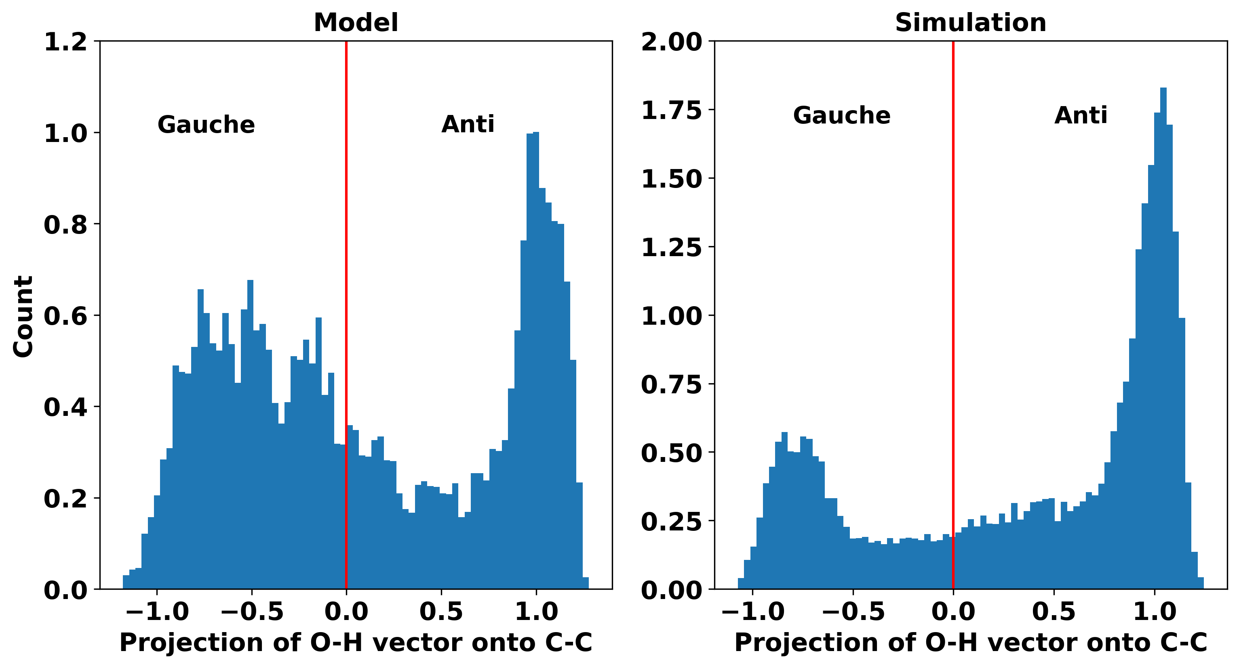
Conformational isomer rate

Slide 9
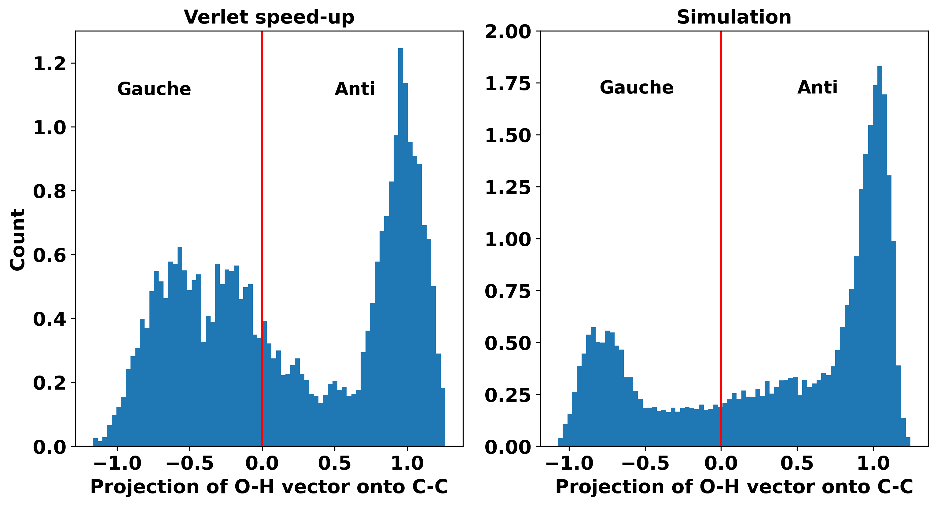
Conformational isomer rate

Slide 10
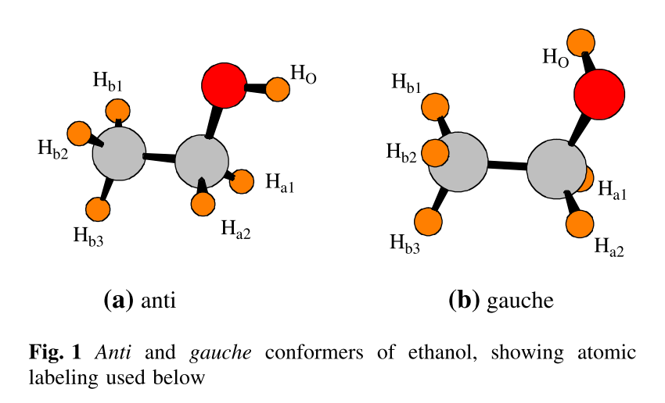
Ethanol’s conformational isomers
Scheiner et al. (2009)
DOI: 10.1007/s11224-008-9395-7

